Slide 1
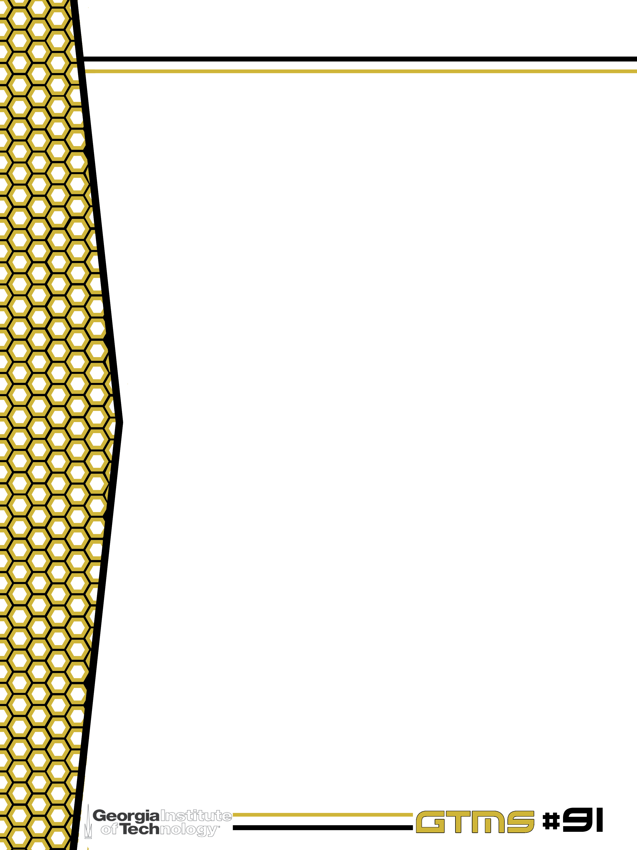

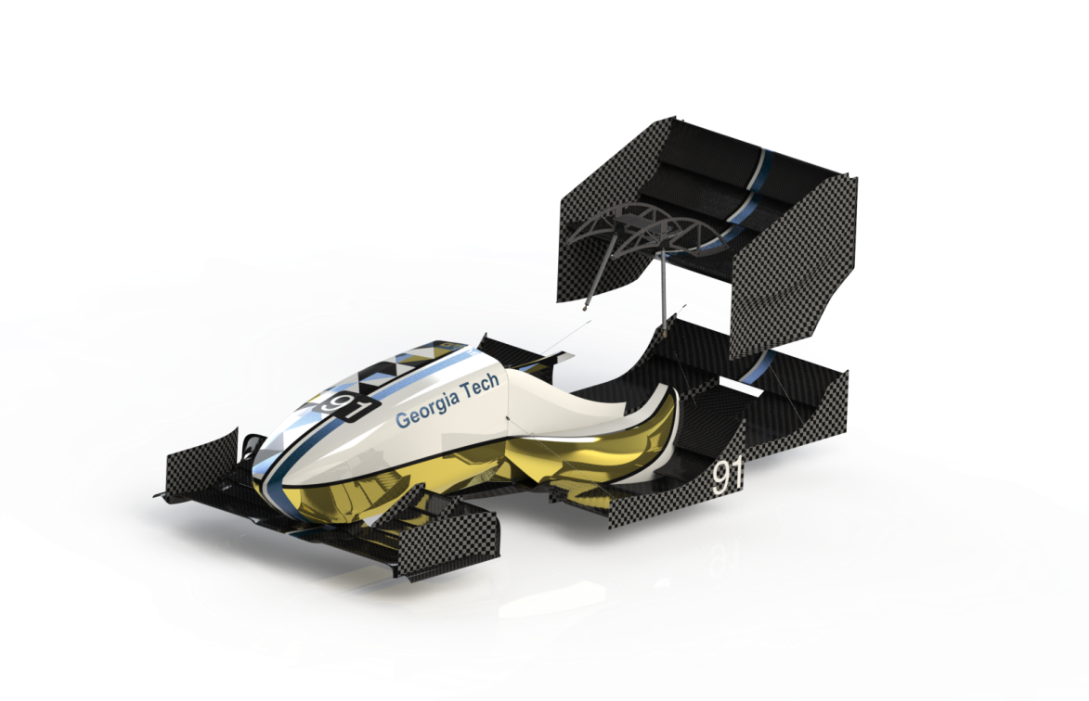
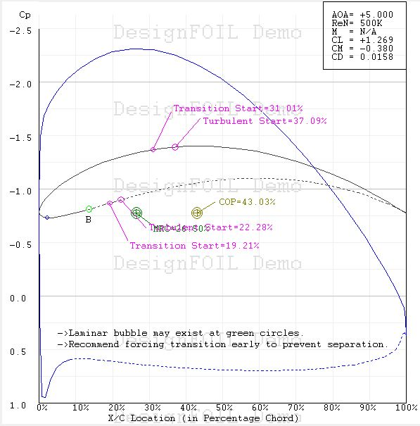
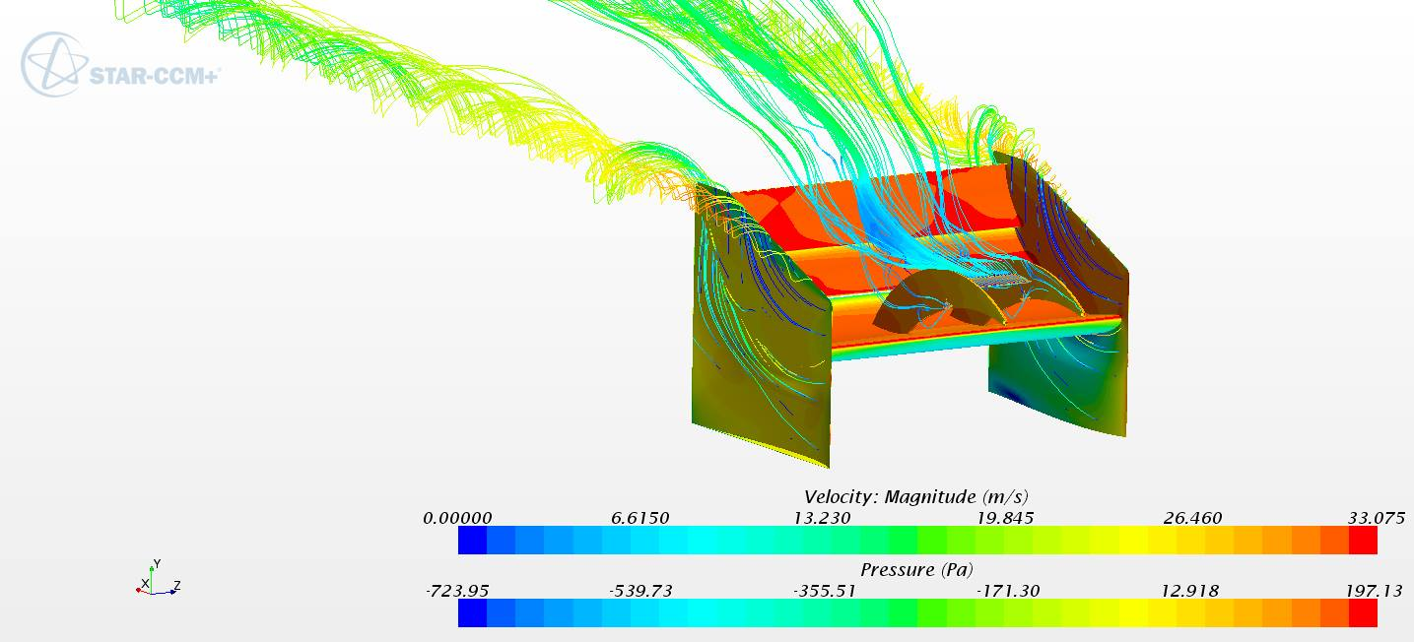
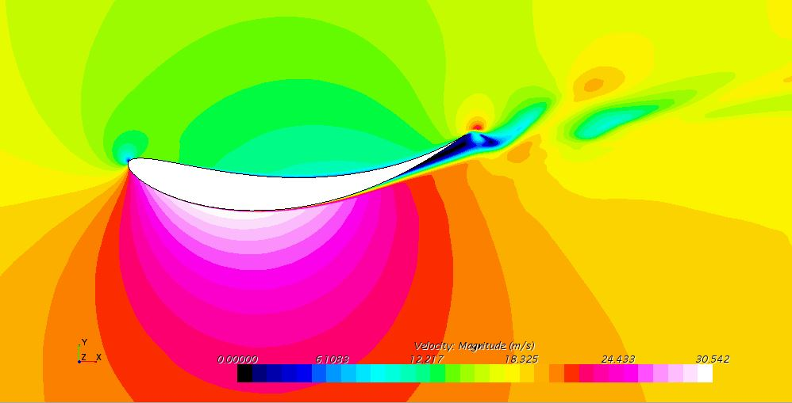
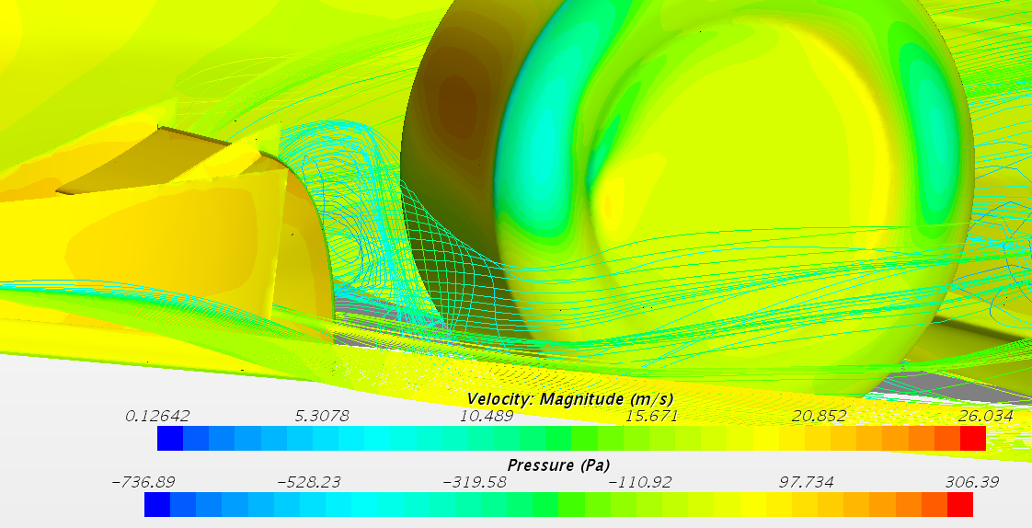
Aerodynamics
Design Goals
Maximize overall downforce
Minimize static weight of system
Balance CoP ~55% rearward to maintain stability under braking
Minimize drag
Features
Concave rear wing endplates
Add 10lb downforce at 40mph
Swan neck mounting design
Multi element front wing
Airfoil integrated into undertray
Side wings
RW main plane DesignFOIL simulation
RW 3D CFD simulation (40 mph)
RW main plane 2D CFD simulation (40 mph)
CFD Overview
40 mph
SST k-omega turbulence model
Rolling tires and moving ground plane
Mesh size: 8M cells
Total downforce: 776N with C_{l} = -2.84
Total drag: 304N with C_{d} = 1.28
FW endplate CFD simulation (40 mph)

